Slide 1
Dynamic HTML and CSS
Requirements Analysis, Design and Implementation
Mad Football
Madan Thapa

Slide 2
Statement of Purpose
The purpose of the site is to attract people to come and play 5-a-side football. The site should be easy to use and user friendly. To provide with a website that will show them where they can play football and how much it cost. This orginisatation is a very big company that has a centre that needs a website that they can use for more promotions and gain even more popularity. It has to offer everything that a 5-a-side football player would look for before join the league. This website should show what the centre offers, where they can find and who are they. Also the client has aske me to show that its more than just for football (there should be like a functions options). The website should be available on all the devices. It should also be very easy to add more pages so as the content start to increase so the HTML and CSS should also be easy to edit.
Constraints
With we developments there is always going to be some constraint and when working with a client there will be more constraints as you don’t have the same mind. One of the constraint will be to deadline, having to finished in a certain time. There might also be some constraint with the contents as I need to wait for them before I can add them on to my website. Also the amount of knowledge of I have with html and css as I don’t know everything that it has to offer.

Slide 3
Other markets out there with the same idea, that I will look at. I will look at some of the few pages and will evaluated for pros and cons and so I can make my website better by using this ideas.
https://www.powerleague.co.uk/
https://www.goalsfootball.co.uk/
http://footballmundial.com/
http://www.premierleague.com/en-gb.html

Slide 4
Power league www.powerleague.co.uk
Sign up
Centre
Preferences
Your details (name, email and phone numbers)
As soon as you enter the page a little pop up windows open, to sign up.
Home page
5-a-side centre (Stockton-on-tees). After selections the centre you are on centre page you are able to set this centre as your home centre.
Home page
Logo on the top left
Navigations bars across the top, clickable links
Big flash slide with latest offers and news about the organizations
More offers and more news (most of them are same for the flash animations, slide) this has more details and you can click on to read more details.
Links to more of their websites with logos and small captions.
Links to some of their sites, on how to contacts and other details like privacy and terms of use
On the bottom you can see their partners.
5-a-side centre
On the most of the things like header and footers are change but the main section has changed drastically.
The pages is long and is divided in to 8 new sections (the sections very form enquiries to kids parties…) all this sections have their own theme.

Slide 5
Power league www.powerleague.co.uk
I wasn’t happy with the idea that you as soon as you entered the website a pop-up is presented telling me to sign up, which I found was annoying and also very demanding as you are told to sign up but you still have know idea of what it is. The page deign of the website is very colour full and lively. There is a lot of thinks to look at. I like how the website has every think that you will ever require for a 5 a-side or a 7a-side football league, which I think is very good, but there is just too much information to do which I think some one with less computer knowledge will find very intimidating. I also like the approval and also the sponsored listed at the button, it make me fell a little more resurging that this is a legit and a professional website and not just a random website. I like the idea of being able to make and account so every thing is saved to your liking, making it easier to see your schedule and tables. I didn’t like the fact that you need to make an account to give enquiries or to hire a function room or to get a party quote. Why not just use the signed information once and used that. Also don’t like how a football website is hosting a kids party and functions. The way there is different theme is great for targeted audience but it doesn’t keep the same consistent while was a little weird to see a the page change for a dark coloured into complete different colourful page. There is a lot of same links on the same page repeated.

Slide 6
Goals football www.goalsfootball.co.uk
Home page
Logo on the top left with, “Enquire Now” button next to it.
On the mid – right there is a small clickable text with “what is goals? | get in touch”. Followed but two buttons for register and login.
Below it is a row of navigations buttons, to others side of the pages. (which drop down menus as you hover over)
There is a flash slide showing the latest/ important news regarding the goals and some pictures and a lots of signup and dropdown list for selecting some of the leagues and centres. (noticed some of the flash players don’t work and some buttons are not clickable I don’t know its that’s was on purpose of not).
They haves there official partners on the bottom after the main sections.
On the very bottom of the page there are small clickable links like terms and conditions, contacts and sitemap. There is also some links to social medias.
There is a small windows that just follows the page, its “chat with us!” if you need help.
home page (lots of things going but not as much as the power league)
Sign up can be on the same page only extends the headers and small form appliers.
5-a-side centre (Teesside). To check your centre you click on “centre” form the navigations.
Signing up
The sign up is very simple. Only askes for you name, email, mobile number and password.
Centre
The centre page was very similar to the home page its was the same replica.
Only the flash slide has shrunk to make room for the centre details where you get a map locations
You are also presented with an address, emails and telephone numbers.

Slide 7
Goals football www.goalsfootball.co.uk
The website was good, its wasn’t very demanding as power league that askes to sign up. The website looks very simple yet there was some many information's. The way that chat options was a very good idea and it would help some one new to navigate and looks around very easy but it was a little irrating, as the little mascot was always there even when you closed the windows down it make its hard to read some of the information's as it was on the way blocking the view. On the centre page there way they had implement the google maps was a very good idea and would make finding the centre very simple as fast. I also like the idea of when the windows resolution is dropped the page on the adapts to it so it make sure that you aren’t scrolling for side to side, which I found very helpful and also it only make hide the unwanted stuff and not the mains like forms and clickable likes. The signing was very easy, simple and fast. There was a problem I found when I was checking the “Tournaments” where it was really hard to red the team names as it table showing the Tournaments was very small. Along with some of the buttons not working. There website was very simple and had good clear and helpful information's which some great ides of implementations. But the lay out of the page wasn’t very good as some of the text were missing. I think there website would be great but I think they tried very hard to fit every single details on such a small page.

Slide 8
Mundial footballmundial.com
Home page
There is a logo on the top right.
On the top left there is social medias that clickable taking you to there site on the mundial.
There is a simple navigations across that doesn’t have a drop down.
On the mains sections there is a form telling you to join. Next to it is a flash slides.
Below it is a about us sections on the right with a small brief discerptions.
Next to it is a what they hope to offered and what there goal is.
On the bottom left is apply now sections telling you why you should apply and a button where you apply.
On the very bottom there is a small text about copyright policy.
home page (unlike the other 2 website that we looked at this ones looks a lot simpler)
Sign up
7-a-side centre (Middlesbrough).
Centre
The centre page has the same header and footer as the rest of the page.
There top of the main section contains the address, time its open, social medias, emails and telephone. With a “apply button next to it”.
Below it contains all the fixtures and results of the cup. There is fixture form week one to the latest week that you can unhide.
It also has the group table and the fixture for each group. Which can be printed.
Signing up
Signing up on this site is more a lot more confusing than other two website. We are asked to fill as manager and also as a play with each players details like name and number and also there is 3 terms and conditions to read before you apply.

Slide 9
Mundial footballmundial.com
This website is probably the most simplest and the only website that was all about football so far and only one where I didn’t find any errors so far. The one in Middlesbrough Only had one league that was 7-a-side. This website had simple negations and it wasn't as flashy as the other 2 but still had good and important information. The back ground also had changed with different page. It stayed constented through out the website with the header and footer being the same. It also had good readable titles and the also make it easy to navigate with the breadcrumbs as navigations. I think the signing up process was a little unnecessary, it was just to long and a little waste of time. It had every thing that was needed for a football website. It had a league table and also all the score and standing, which I would loved to have form the a football website unlike just a league table it would be great to see who is playing who and the past week scores. The options to print form and fixtures is a good idea.

Slide 10
Premier League www.premierleague.com
Home page
The home page has the main logo on the top left and is bigger then the others that logos (clubs logo), this logos are clickable and will take to their club’s home page.
Below it there is a table with match fixtures that you can book tickets or see what channels they are going to be at.
After that there is a flash slide that shows the news featured, video and images along with stats of the standing.
On the main section there is more headlines from each clubs, some news that doesn’t related to any of the clubs and also a table should all the clubs standings. There is also a poll where the users can vote on some questions, players profile with there scores, position and other details. There is also a tweets sections form each clubs. Section on a virtual tours of all the stadium of all the clubs and some upcoming events.
On the footer of the page there is few clickable likes to about page, commercial, fans, youth, referees, contact us, site map and mobile site. Below it is a few of their sponsors and on small front there is like to terms and conditions privacy, cookie policy and back to top.
home page
Sign up
Club (Man Utd)
Sign up
Signing up for this website is very simple as this is not for the actual use of play football. You are only able to look at the website, Therefore you only need an email and password to signup and log in.
Club (Manchester United football club)
You are taken to the different page with the same header and footer as the home page.
The main sections is also similar but the colour has changed and now it all related to the club, like the flash slide is changed to some pictures of the clubs stadium and all the standings and fixtures to just showing the clubs ones. There social medias just shows the clubs ones. There is also a shop to buy man utd kits.

Slide 11
Premier League www.premierleague.com
I like this way it is kept concistent through out the website pages. I like how each clubs has the its own page and that is pesific to that club and nothing else and still keeping the same page format as the header and footer changes. There slide was smooth and all the buttons worked perfectly and there was no glitches I found. As the resolution changed to the website changed too to make it so that you didn’t have to slide from left to right. I understand how this is a proffesnoal league and that you are not just able to sign teams, so the signing up process was very simple. The home page and its animations worked very well. There text were easy to read and the colour choices was very nice. There way it was layed out and had so much information's was just great. It was a little different form other website that I visited as this was for proffesnoal players while the other were just for anyone that wanted to paly.

Slide 12
Audience (Target audience, User scenarios, Accessibility)
My primary audiences are going to be people who wants to join a football league. 18+
Secondary are going to be people that are going to want to book a functions or pitch. (kids and parents)
Tertiary Other companies looking for completions or some one looking for a job.
Primary (Rick Bowman, 19 , student)
Rick Bowman an 19 year old student at Teesside university. He is looking to join the league that close to his place and is cheep. He is has a few friends that wants to join as well, they would like to make a 5-a-side team but all of them are new to this area and want don’t know a lot about this place. That evening when he had enough players to play a 5-a-side football, he went on his laptop and on google typed in “5-a-side football near Teesside”. From the list of website he click on the link from the list. He is then presented with a home page of my website. He looks at for the address of where the football pitch is held at, so he goes checks the centres that says “Teesside” for a list of centres, and his is then presented with a different page where its has all the information on the centre like; address/map, phone numbers, emails, teams, fixtures, some photos of the centre and price for a game. He then checks the “about page”, to get more information on the company. He is happy about what he reads and see so he decides to sign up and join the league. He click “signup” link form the header and is presented with a popup asking for; emails, password, phone number, age and what centre he would like to join.

Slide 13
Secondary (Sofia Duncan, 28, housewife)
Sofia Duncan is a 28 year old married and a full time mother. Has with 2 twins 9, both football fans. As there birthday is just a week away she wants too find a place where the twins and there friends can play football and while theirs parents can also hang out/ relax and talk. She askes her friends is there is such a place, one of her friends who plays for 5-a-side gives a links to her. She taps on the link taking her to my website booking functions page. She read through the page that contains Address/ map, pictures of the venue and pitches, booking cost per hour, contacts details and some discerptions of what they can also offer you like balls, food/ drinks, bibs, referee, clowns and stuff. She is impressed by the friendly and cheerful page and also happy about the place, so she calls the company using the numbers on the contacts details, asking if they could book the venue for 5hours, they tell her to book it through the website as they require her card details. So she goes back on the top of the “booking function page” where she finds a button with the text “book function now”. When clicked on the button she is presented with a forms asking her to enter her details like name, number, age, emails and also aske which venue she wants to book and for how long along, what date for and write a little message about why she would like to book and the total price will appear. She is also asked to agree with the terms and policy Which basically say that if anything is damaged or stolen she will be the one to be charged. Than she clicks on the next page she is asked to enter her card details and after that she is done. She has successfully booked the venue and now is goes off to buy her sons gifts.

Slide 14
Tertiary (Amulius Liber, 22, web designer)
Amulius is a 22 year old web designer. He was recently asked by “Random 5-a-side” manager to design a website page. As Amulius had good knowledge of football and the pay was good he took the jobs, with out any questions. He than gest to his computer to do some market research about 5-a-side website, so he goes to google and types in 5-a-side football. He comes across my website and clicks on the link taking him to the home page of the my website. He reads through some of information on the home page, goes to the centre he is closest to, read some information and scrolls to the bottom of the page and reads the contacts details and clicks on the logo to go back to the home page, He goes to the sign up page and records what the website requires. He reads some of the things on the about page. He has a little scroll through the website checking; colour, information, text, layout and other. He than goes through the website writing down notes as he goes through the website pages, from home page, sign in page, looking at the league page, checking out the different centres and finally looking at the site map, contacts and about page. They will also want to know how accessibility is, so they are most likely going to have a screen read where they will see all the images and slides show being able to read. They will also notice the accessibility link on the footer. There they will see some of the things that I have included for easy reading. Like colour changer, font sizer and alt tags.

Slide 15
Accessibility
Accessibility is very important on the website as it’s the law to have this. This is because people who have difficulty reading/ browsing the website. If they accidentally stumble or are actually planning to join a 5-a-side football it is good to have some short of thing that can help them. Therefor I have added “alt tags” to every images and videos which would work with the screen reader. I have also added a page just for accessibility. This page will contain colour changing of the text and also the size of the fonts. This will hopefully help the people using who have difficult much easier to browse.

Slide 16
Content Model
General information's
Company information
Leagues table
Game time
Centre information's
Rules and relegations
Links to all my website pages
Address, number and emails
Accessibility
Sponsors name and pictures
Enquire form
Ranking list
Booking prices and information
Functions information
Staff member title and pictures
Enquire conformations
Home page can be accessed form any page.
Site map can access any page.
Form for booking
Form for Function
Booking conformations
Function conformations

Slide 17
Contents and Requirements
What the clients wants:-
Address
Cost dates
Photos (some will be provided by the clients)(some are going to be form the internet, I will try to avoid any copy right but if needed I will ask the owner beforehand)
Parking's
Functions
Food/ drinks
My logo will be created by me, obviously I will ask my clients for suggestions and make improvements using their suggestions. Pictures and videos will be taking by both me and clients, I will also be getting some pics off the internet. I will try to avoid using copy rights contents, but if not I shall email the owner and ask them my self.
As the information like date, fixtures, food drinks, parking and prices will be provided by the clients and along with the teams name but I will be them myself if my clients are unable to make up as its not going to be hard.
I will look at other website rules and relegations as most of the 5-a-side football have similar rules and relegations to work with. I will add some of my own or change some because rules aren’t really that necessary and some aren’t provided that will make a 5-a-side more fun and unique form our competitors.
As for the login and signup will be picked by the users them self.
I will also take enough content by myself so I do not have to worry about if my clients aren’t able to provide contents for me.
What I want to add:-
Match Fixtures
Team signup / login
Prices for booking (pitches and functions)
Jobs vacancies (printable forms)
About page (what 5-a-side is and what we hope to achieve)
Fixtures and table for leagues
Rules and relegations
Players profiles

Slide 18
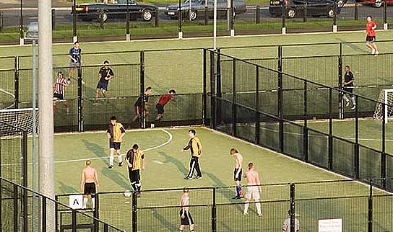

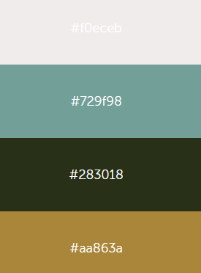

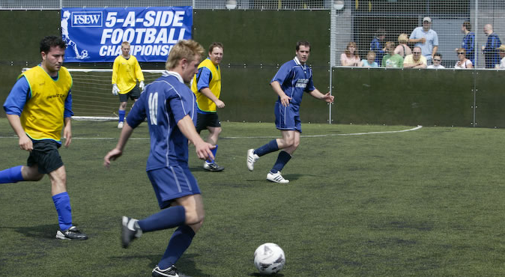
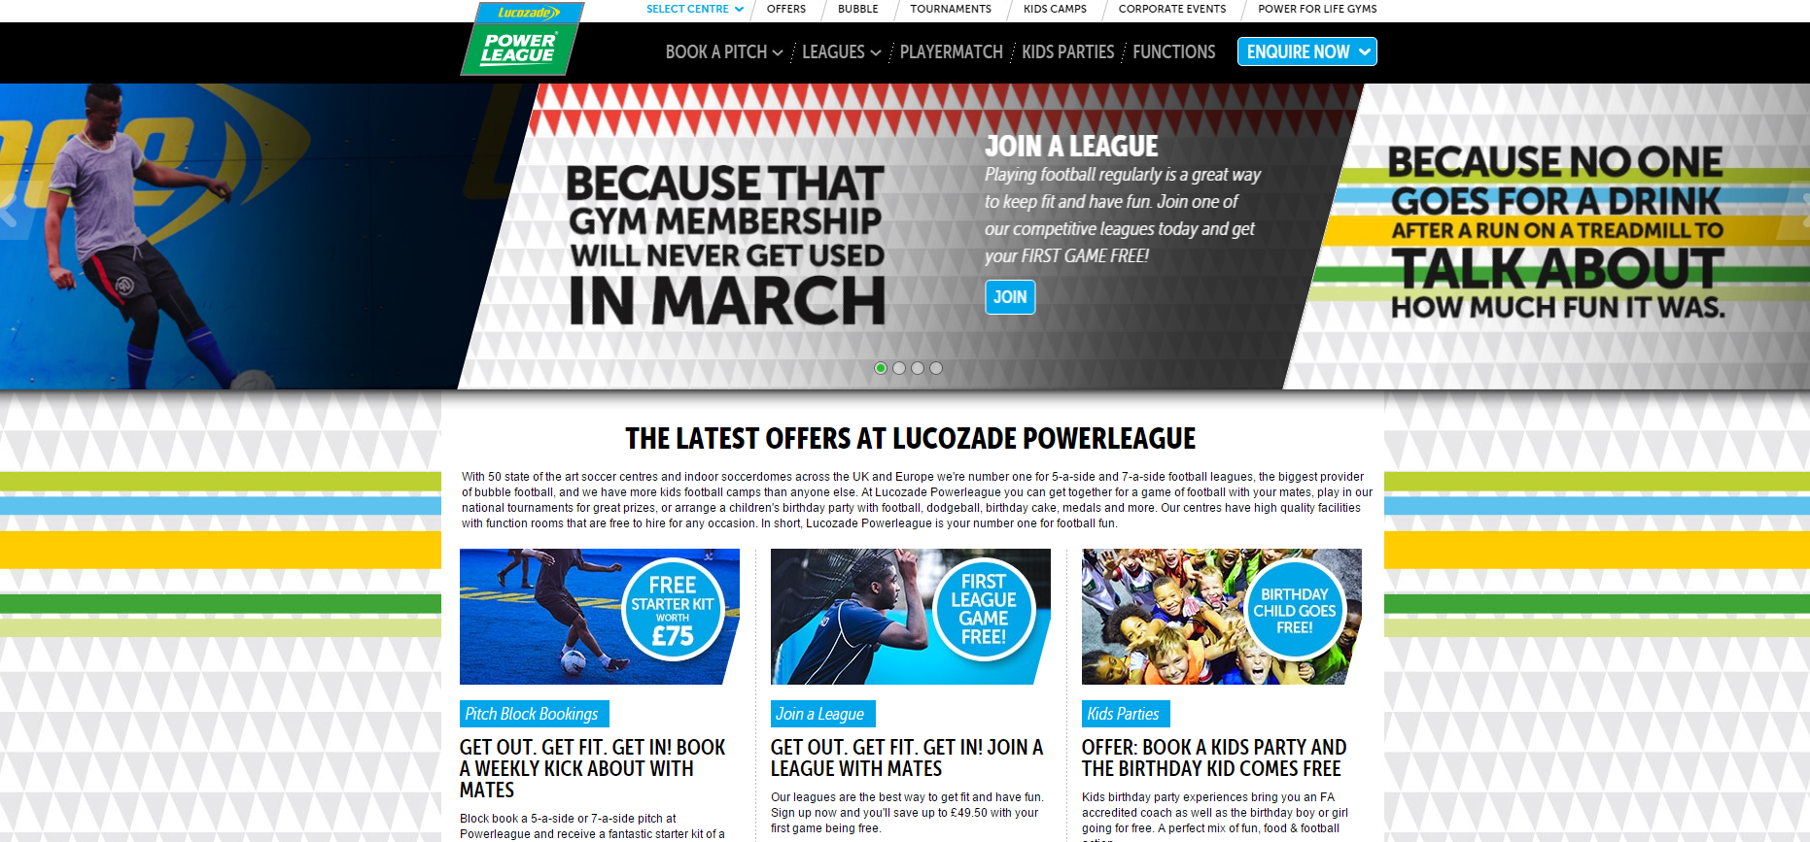


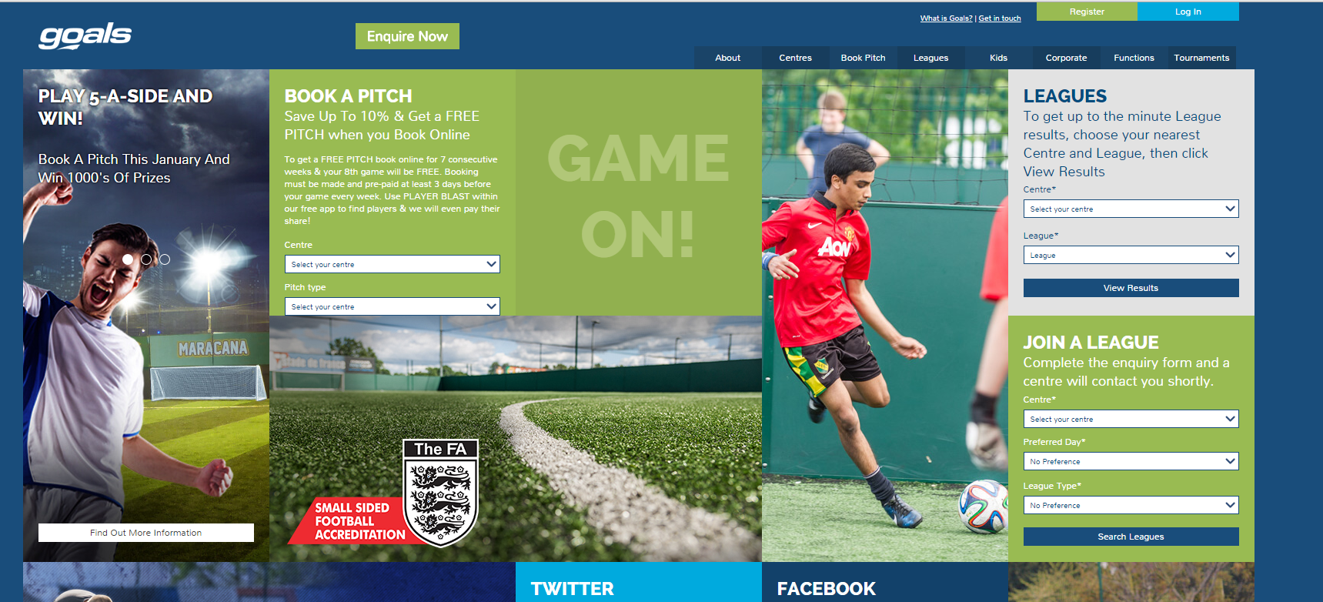
Project name:- Footballs and Goals
Designer Notes
The design is going to be simple and user friendly as I can make it, the navigations is going to simple and standard type. The bar will change from horizontal to vertical moving from big screen to little screen to make so there is little to no side scrolling.
The website will follow the colour palette shown on the side. This includes form navigations bar, text and also logs throughout the website pages.
Any thing over 1024 regulation will be desktop design, form 1024-800 will have a tablet design and less than that will be a mobile (small screen).
Colour Palette
Pictures
https://www.powerleague.co.uk/
Other Design Elements
Texts Font, Colour and Size
Header
Subheading
This is going to be the normal text in a paragraph. This will also include list like the one below this list show the colour and the type or font that was used for each one :-
Header – font: Kozuka Mincho Pr6N EL , size: 32 , underline: Yes
Sub heading – font: Calibri Light (Headings) , size: 18 , underline: Yes
Text – font: Adobe Devanagari , size: 12 , underline: No
Hyperlinks – font : Adobe Devanagari , size: 12 , underline: Yes
Similar websites
https://www.goalsfootball.co.uk/
Logo 1
Logo 2

Slide 19
Navigations
Desktop navigation bar (1024 or higher)
Most of my site movements will be done form a navigations bar. This will be found on the top centre of the page, it will be placed horizontal. This will mean that that it will be easy for the people to navigate through the page. The navigating bar will just used the title of the page and if the name is to long it will just use a initial. The colour schema will follow the colour palette and so will the text on the navigations bar. This navigation bar will be downtown menu for subpages. The navigations will just include the main contents, for the 5-a-side and will not include details like about or contacts. This is going to be because I want the user to find what they want more quickly and faster, also this makes it a lot simpler to navigate. The navigation bare is going to be 1024 long and if the regulations is higher it will stay the same and if its smaller it will be a tablet/mobile form.
Tablet navigation bar (1024 to 800)
Just like the desktop The navigation bar will be the same colour and so as the text, it will be found on the top centre of the page. Although the text will be the same size and same font, the bar/boxes itself will be small size. I will also remove the pop out menu because it doesn’t work well with a touch screens, instead they will have their little own navigation bar. This one will be much smaller font and smaller boxes. This will be found right below the main navigations bar. Like the desktop one this will just contain the main contents.
Phone navigation bar (800or less)
For the main navigation bar is hidden and there will be replaced with a little button and when clicked on it will open up a little menu selections. This selection will open up a navigation bar but it will be horizontal and will also show both main and sub pages. There colour scheme will be the same, the same size as the one tablets. The main and sub pages will be on different bars.
Text navigations
There will be some text that will be clickable. This may be found either in the footer where I will be linking to other websites or contacts/about pages. This is so that the main content of the website are found easily and that they are separated form it. There text will be different form the normal text, this will also change colour once the link is clicked and visited. This wont be the same case with the internal link that belong to the my website, this will include contacts and about page.
Graphic navigations
There will also be some graphic links. The main and most obvious one will be the logo which will take you to the home page. I am also planning on making it so that when the map is opened it will take you to the google map with the address of my company (office). I am also planning on having some pictures clickable to make it bigger or to read some cations.

Slide 20
Navigation
Home
about
Leagues
Fixtures
Centre
Rules
sitemap
Contacts
Accessibility
Sponsors
Enquire
Ranking
Booking
functions
Staff member
Enquire conformations
Home page can be accessed form any page.
Site map can access any page.
Form for booking
Form for Function
Booking conformations
Function conformations

